Slide 1
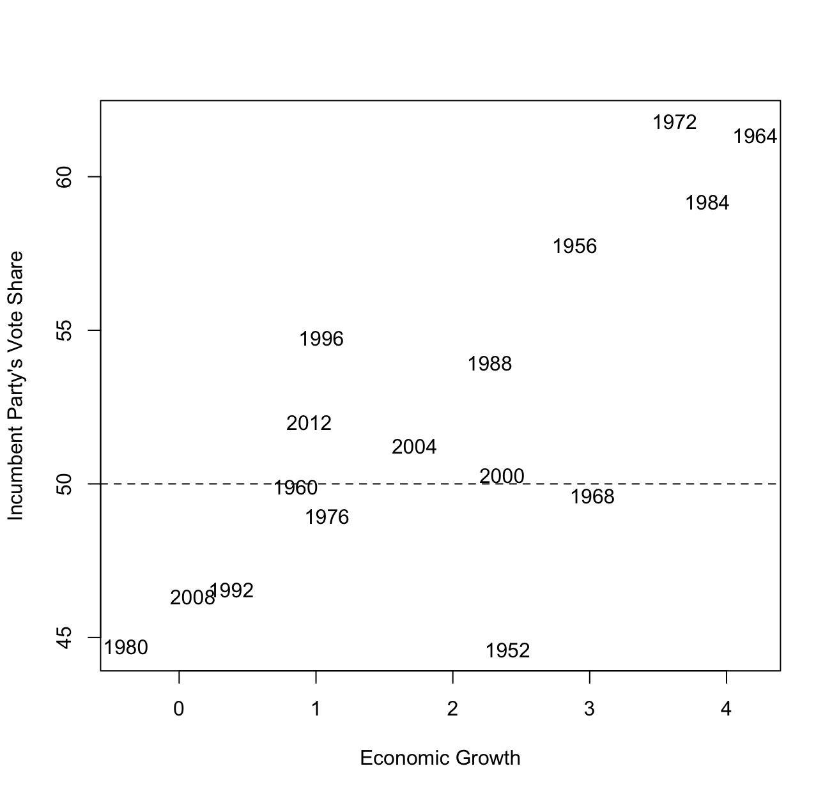
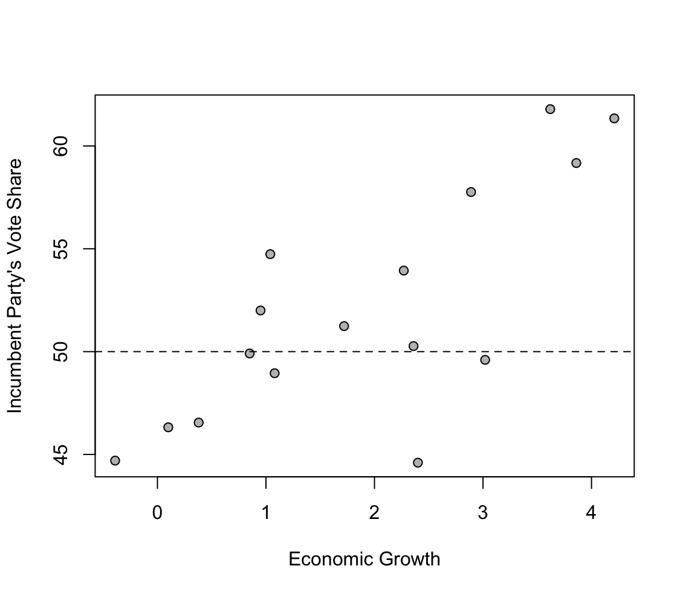
The data on economic growth and vote share

Slide 2
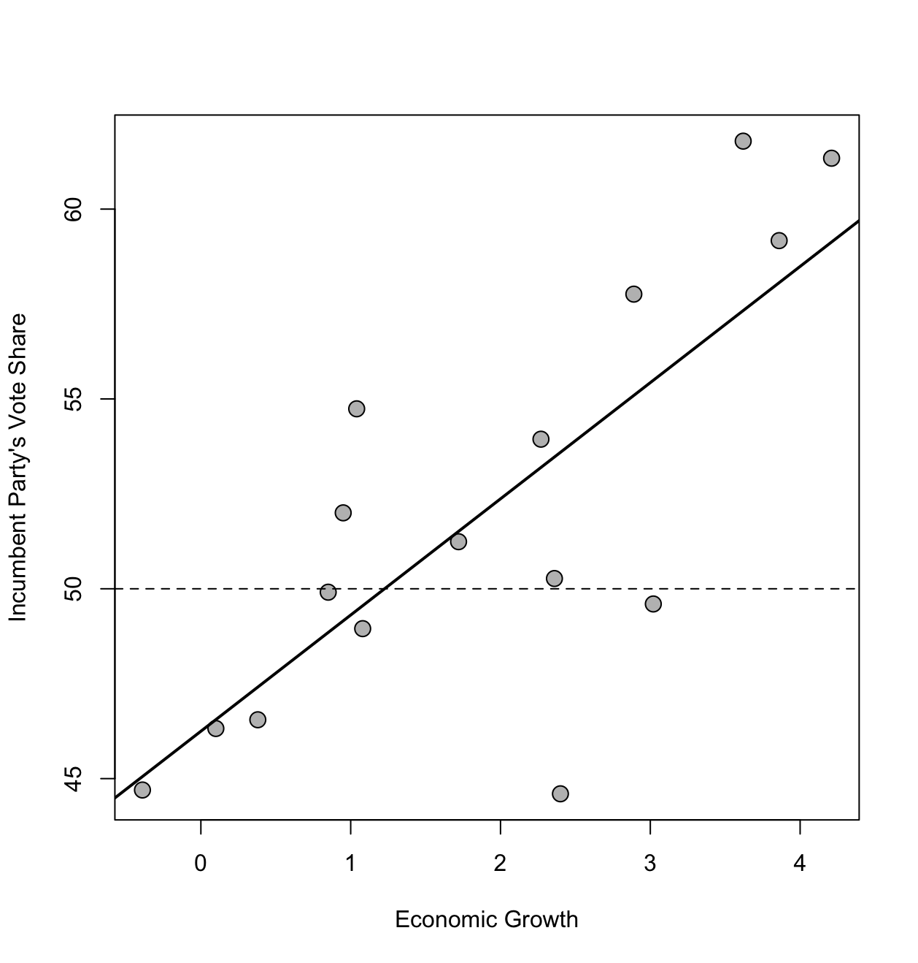
Model Outputs
Residuals:
Min 1Q Median 3Q Max
-8.9929 -0.6674 0.2556 2.3225 5.3094
Coefficients:
Estimate Std. Error t value Pr(>|t|)
(Intercept) 46.2476 1.6219 28.514 8.41e-14 ***
growth 3.0605 0.6963 4.396 0.00061 ***
---
Signif. codes: 0 ‘***’ 0.001 ‘**’ 0.01 ‘*’ 0.05 ‘.’ 0.1 ‘ ’ 1
Residual standard error: 3.763 on 14 degrees of freedom
Multiple R-squared: 0.5798, Adjusted R-squared: 0.5498
F-statistic: 19.32 on 1 and 14 DF, p-value: 0.00061

Slide 3
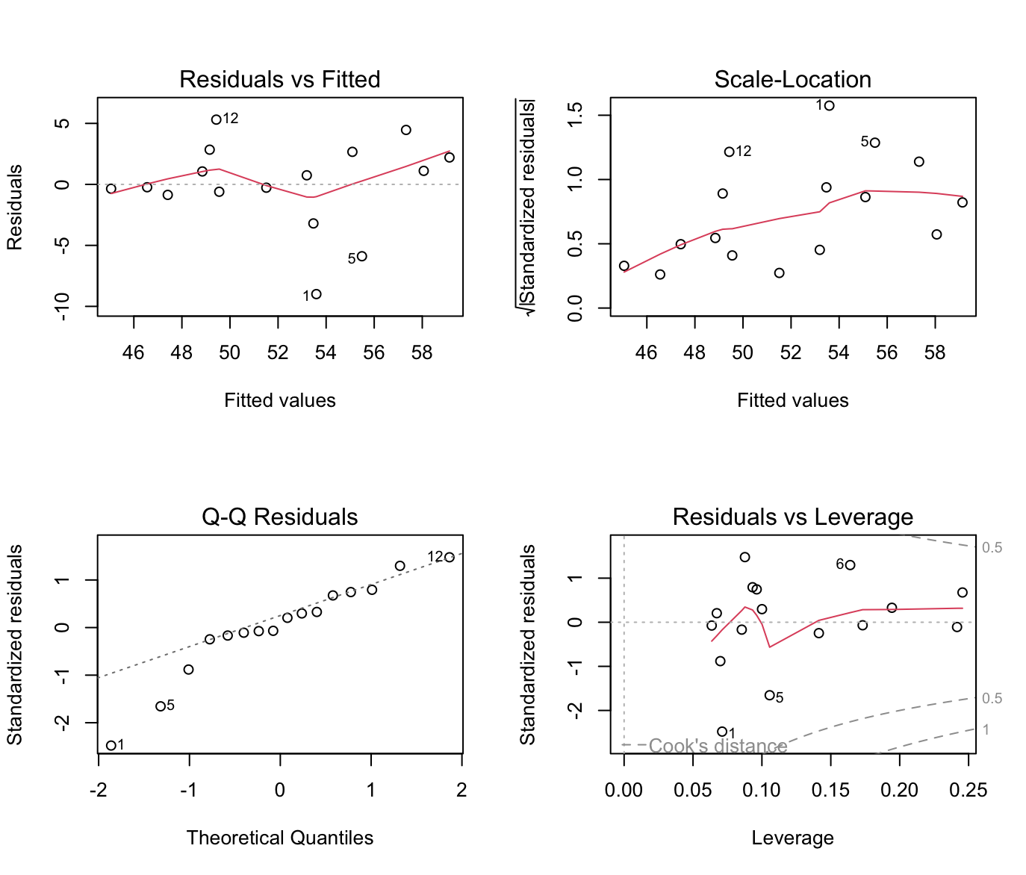
Regression Diagnostics

Slide 4
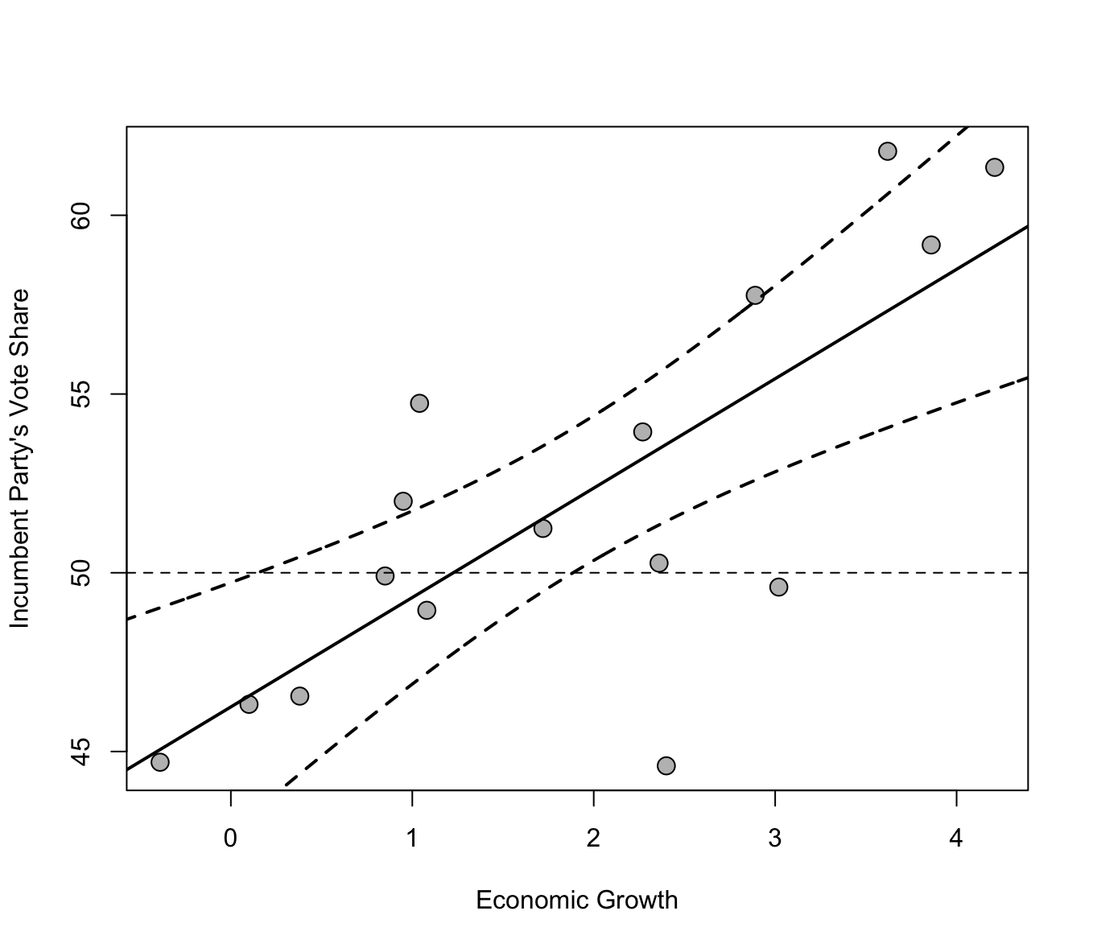
Confidence Intervals
Residuals:
Min 1Q Median 3Q Max
-8.9929 -0.6674 0.2556 2.3225 5.3094
Coefficients:
Estimate Std. Error t value Pr(>|t|)
(Intercept) 46.2476 1.6219 28.514 8.41e-14 ***
growth 3.0605 0.6963 4.396 0.00061 ***
---
Signif. codes: 0 ‘***’ 0.001 ‘**’ 0.01 ‘*’ 0.05 ‘.’ 0.1 ‘ ’ 1
Residual standard error: 3.763 on 14 degrees of freedom
Multiple R-squared: 0.5798, Adjusted R-squared: 0.5498
F-statistic: 19.32 on 1 and 14 DF, p-value: 0.00061
These represent where 95% of the best fit lines are

Slide 5
Measure of Fit
Residuals:
Min 1Q Median 3Q Max
-8.9929 -0.6674 0.2556 2.3225 5.3094
Coefficients:
Estimate Std. Error t value Pr(>|t|)
(Intercept) 46.2476 1.6219 28.514 8.41e-14 ***
growth 3.0605 0.6963 4.396 0.00061 ***
---
Signif. codes: 0 ‘***’ 0.001 ‘**’ 0.01 ‘*’ 0.05 ‘.’ 0.1 ‘ ’ 1
Residual standard error: 3.763 on 14 degrees of freedom
Multiple R-squared: 0.5798, Adjusted R-squared: 0.5498
F-statistic: 19.32 on 1 and 14 DF, p-value: 0.00061
58% of the variability in election outcomes is explained by economic growth

Slide 6
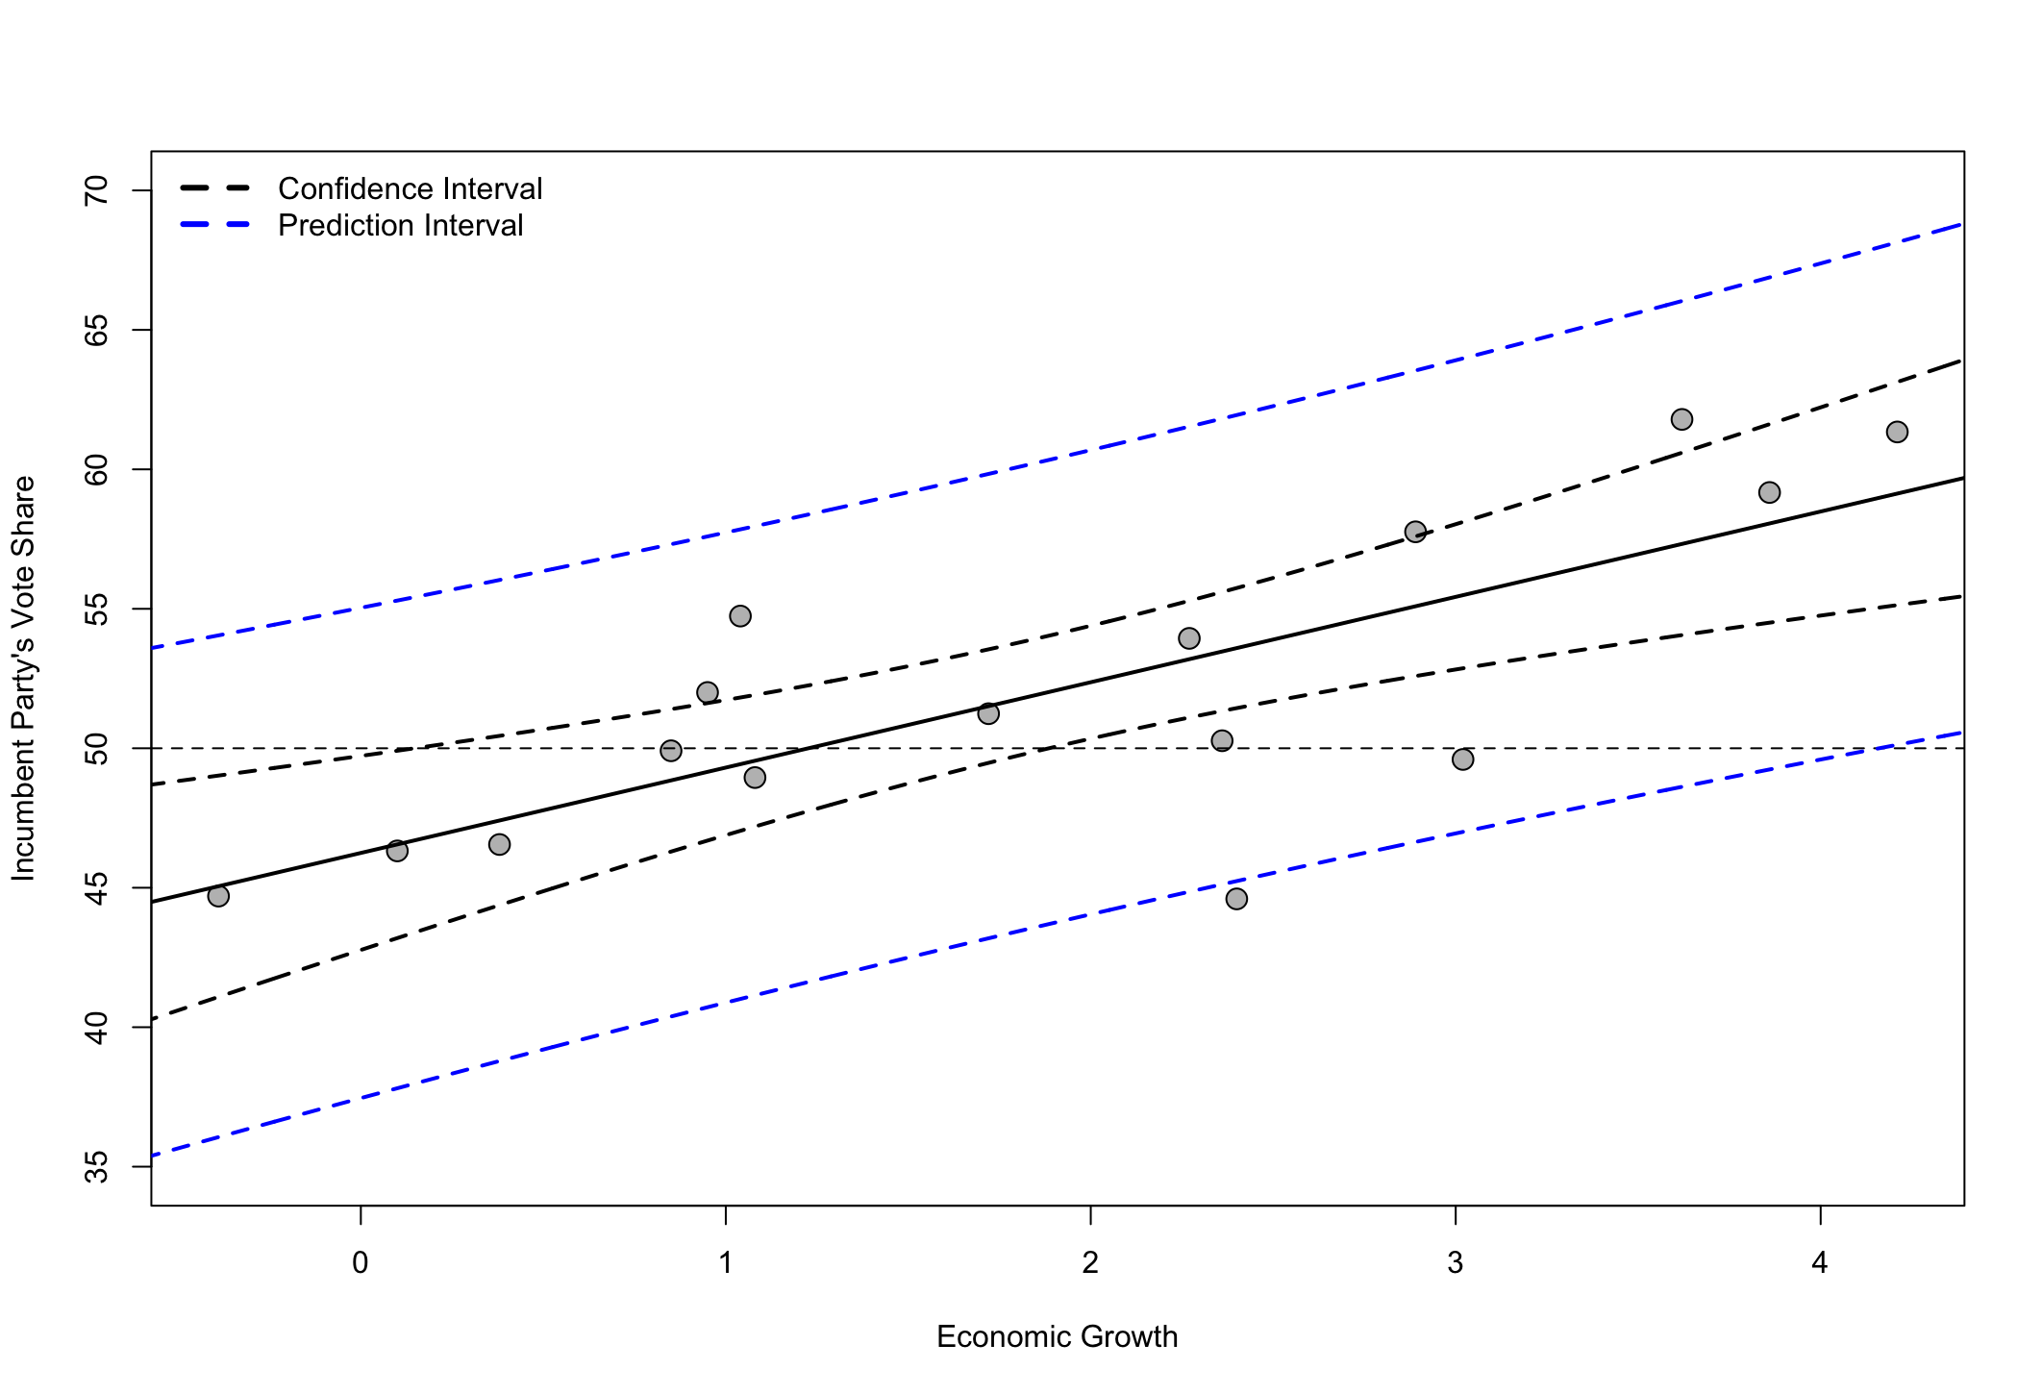
Prediction Intervals
Residuals:
Min 1Q Median 3Q Max
-8.9929 -0.6674 0.2556 2.3225 5.3094
Coefficients:
Estimate Std. Error t value Pr(>|t|)
(Intercept) 46.2476 1.6219 28.514 8.41e-14 ***
growth 3.0605 0.6963 4.396 0.00061 ***
---
Signif. codes: 0 ‘***’ 0.001 ‘**’ 0.01 ‘*’ 0.05 ‘.’ 0.1 ‘ ’ 1
Residual standard error: 3.763 on 14 degrees of freedom
Multiple R-squared: 0.5798, Adjusted R-squared: 0.5498
F-statistic: 19.32 on 1 and 14 DF, p-value: 0.00061
Where 95% of elections will be

